Slide 1
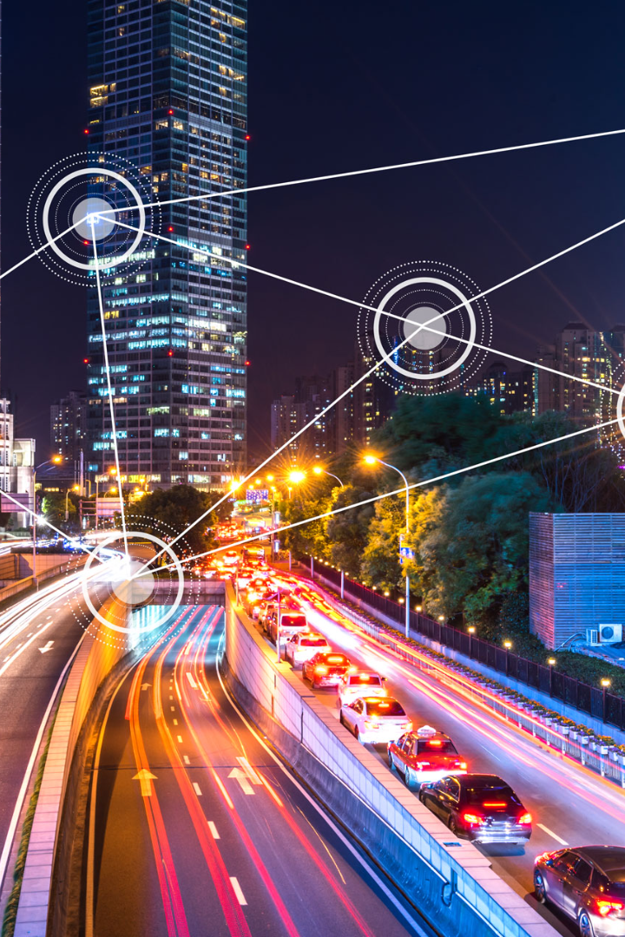

Public Transportation and Optimization in IoT
Discover how the Internet of Things (IoT) is revolutionizing public transportation, enhancing efficiency, reducing costs, and improving passenger experience.
CA
by CHINNATHAI A

Slide 2

Integrating IoT in Public Transportation
1
Real-Time Data 🌐
IoT allows for the collection of real-time data, enabling better decision-making and proactive maintenance.
2
Smart Infrastructure 🏗️
IoT sensors and devices can monitor the condition of infrastructure, optimizing maintenance and reducing downtime.
3
Enhanced Safety 🚦
IoT-enabled systems can improve safety measures, such as automated monitoring for potential hazards and emergencies.

Slide 3

Challenges in Implementing IoT
1
Connectivity Issues 📡
Reliable connectivity is crucial for IoT systems to function effectively, but coverage gaps and signal interference can pose challenges.
2
Data Management 🔒
The massive amount of data generated by IoT devices requires robust data management systems to ensure data security and privacy.
3
Integration Complexity ⚙️
Integrating IoT into existing transportation infrastructure may involve complex processes and coordination among multiple stakeholders.

Slide 4
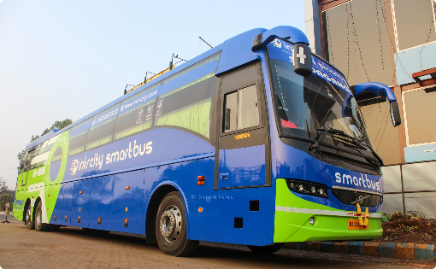
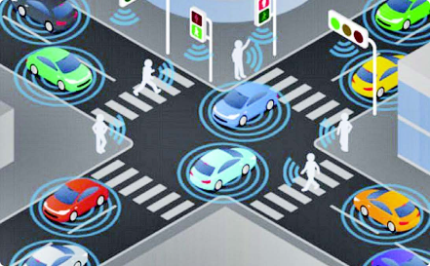

Successful IoT Deployments in Public Transportation
Smart Bus Systems 🚌
IoT-enabled buses equipped with GPS and passenger monitoring systems have enhanced operational efficiency.
def sys_init(): global loraM, client obtain_port()
#Twilio Client Initilize client = Client(ACCOUNT_SID, AUTH_TOKEN) print("Primary Comm Mode, Twilio Sync Initialized\n") # LoRa module Initialze on the given Port loraM = MCLoRa(port) success = loraM.testOK() if success: print("Secondary Comm Mode, LoRa RF Initialized\n") print(success) print(loraM.getUniqueID()) else: print("Secondary Comm Mode, LoRa RF FAILED....Exiting\n") sys.exit(0) loraM.pause()
Smart Traffic Management 🚥
IoT-based traffic lights adjust signal timings based on real-time traffic conditions, reducing congestion.

Slide 5
Optimization Through IoT
1
Sensor Integration
Install IoT sensors in vehicles and infrastructure to collect valuable data on performance and usage patterns.
Data Analysis
2
Utilize advanced analytics and machine learning algorithms to gain actionable insights from the collected data.
3
Smart Decision-Making
Leverage the insights to optimize routes, schedules, and maintenance processes, improving efficiency and reducing costs.

Slide 6
Future Prospects of IoT in Public Transportation
Connected Mobility 🌐
Artificial Intelligence 🤖
IoT will enable seamless integration of different modes of transportation, facilitating multi-modal journeys.
The combination of IoT and AI will enable predictive maintenance, personalized services, and dynamic resource allocation.
Smart Cities
Passenger Engagement 📲
IoT-powered public transportation systems are a key component of smart cities, promoting sustainability and livability.
IoT technologies will enhance passenger experience through features like real-time journey updates and personalized services.

Slide 7

Continued Investment in IoT
1
Economic Benefits
IoT-enabled public transportation can drive economic growth, boost productivity, and attract investment.
2
Sustainability Goals
IoT can contribute to reducing carbon emissions by optimizing transportation systems and promoting the use of greener alternatives.
3
Improved Quality of Life
Efficient and reliable public transportation supported by IoT enhances accessibility and mobility for all members of the community.

